Slide 1

IT-648: IT Risk Management
Week 7
Sonja Streuber

Slide 2
Agenda
# | Topic | Reading | Due 11:59 pm CST on Blackboard
7 | Encryption Controls: Encryption types and their details, Encryption in use | Agrawal 7 Other materials on Blackboard | W: Post F: Responses S: LAB_7

Slide 3
Chapter 7
Encryption

Slide 4
Overview
By the end of this week, you will be able to:
Define the three types of encryption commonly used and their most appropriate uses
Describe the standard, practical implementation of encryption technologies used in information exchange
Apply the alternate use of encryption technologies to verify identities in the form of certificates
Use the infrastructure (PKI) that has been developed to make encryption convenient and practical

Slide 5
Introduction
Motivation
Communication needs
Transmission alone often not enough
Privacy
Identification
Integrity
Encryption accomplishes all these features
Remember, though
Encryption cannot compensate for human weakness
Sharing passwords, not using encryption etc

Slide 6


Encryption overview
Plaintext
Ciphertext
Plaintext
Encryption
Decryption
Hello
#er5*!@-+=hdg
Hello

Slide 7
Encryption terminology
crypto (κρυπτο)
Hidden
graphy (γραφη)
Writing
ATIS telecom glossary
Encryption
Cryptographic transformation of data to produce ciphertext.
Cifr
Arabic for empty

Slide 8
Origins
Caesar cipher
Julius Caesar
100 B.C. – 44 B.C.
A → D
B → E
Q → T
W → Z
X → A
Y → B
Z → C
Mono-alphabetic substitution

Slide 9







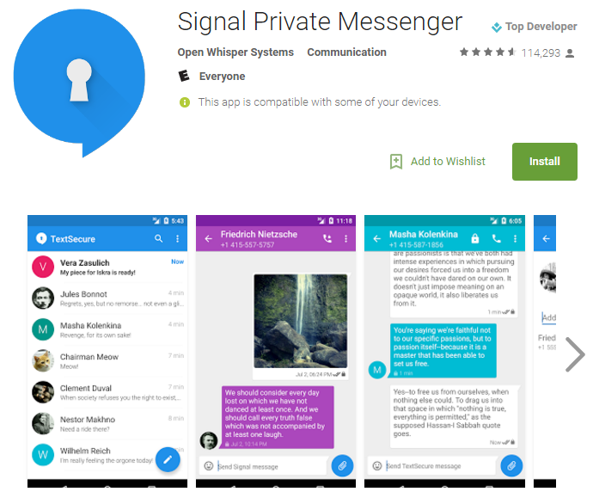

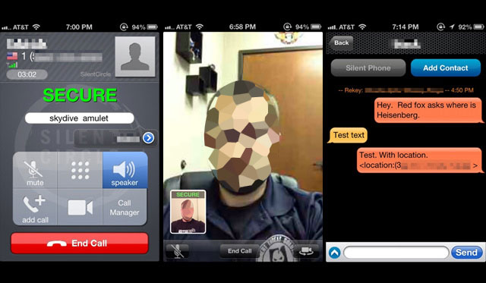
Encryption – limitations
Enables secret communications by terrorists
Reduces effectiveness of firewalls
IMPEDES FORENSICS
Used by ISIL (Daesh) to plan attacks;
ISIL now uses Alrawi
SilentPhone

Slide 10
Encryption – requirements
Desired properties
Easy to use for owners & Difficult to break for intruders
Similar to locks
Need not be perfect or unbreakable
Only need to deter intruders by drawing the attention of onlookers
In information security
Ease measured in terms of computational effort
Resistance to cryptanalysis
Art of breaking ciphertext
Can be clever: Need not understand text to break encryption
E.g. mono-alphabetic substitution
Using e > t > a > I > o > n > s > h > r > d > l > u
Can be broken in approx. 600 characters
Also guessing probable words
Only about 150 characters are needed

Slide 11
Encryption keys
Definitions
Cryptographic algorithm: Well-defined sequence of steps used to describe cryptographic processes
Cryptographic key: Sequence of symbols that controls the operations of encipherment and decipherment
Few lock & encryption types
Need to meet requirements: Biometric, numeric, keys
How to use limited lock types to secure unlimited number of gates?
Change keys or combinations
As with physical locks
Change keys for each use of the same encryption algorithm
Encryption operation basics
Users with the correct key can easily exchange information
Eavesdroppers will take a prohibitively long time

Slide 12
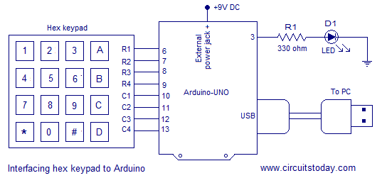
Encryption key lengths
Consider number locks
Say, user takes 1 second to check one digit
Expected time to break a 1-digit lock?
Minimum time – 1 second
Maximum time – 10 seconds
Expected time – 5.5 seconds
Typical locks have 3 – 4 digits
@ 1 second per combination
3 digits
Expected break time: 500 seconds (~ 8 minutes)
4 digits
Expected break time: 5000 seconds (~ 83 minutes)
Real-world keys have 100’s or 1000’s of digits
Arduino lock

Slide 13
General encryption algorithm properties
Randomization of input
Output should appear to be a random collection of bits
Any observable pattern can be exploited
However, randomization should be recoverable
Randomized length of output
Length of output from given input should be unpredictable
Else, can reveal information
Randomizing effect of each input bit
Changing one bit in the input should change approx. half the bits in the output

Slide 14
General encryption operations
Objective
Confusion
Making the relationship between the plaintext and ciphertext as complex as possible
Diffusion
Spreading the impact of a change in one bit of the plaintext to all bits in the ciphertext

Slide 15
General encryption operations
Encryption Operations
Substitution
Specifying the output for each input
Generates confusion
Permutation
Specifying the output position of each input bit
Diffuses the confusion generated by substitution
Prevents exploitation by specially crafted inputs

Slide 16
Encryption types
Encryption type | Keys | Applications
Hash function | 0 | Password protection, data integrity check
Secret key cryptography | 1 | Secure data storage and transmission
Public key cryptography | 2 | Secure key exchange, authentication, digital signatures

Slide 17
Secret key cryptography
Simplest encryption procedure to understand
Uses two procedures
Block encryption
Process of converting a plaintext block into an encrypted block
Cipher block chaining
A way of combining encrypted blocks
Example shown is based on DES
Data Encryption Standard

Slide 18
Block encryption
Block encryption overview
Split data
DES splits data into 64-bit blocks
For each block
Split data into two halves
Mangle the bits
Substitution operation for generating confusion
Combine the mangled bits
Permutation operation for diffusing confusion
Repeat multiple times
DES repeats 16 times; AES repeats 10 – 14 times

Slide 19
Encrypting larger messages
Block encryption encrypts 64-bit blocks
How to encrypt a large file
Say, a 1 MB Word document?
Simplest procedure is called electronic code book
ECB
Not very secure
But intuitive to understand
Problems?
Figure on next slide

Slide 20
Electronic code book

Slide 21
Encrypting larger messages – CBC
Cipher block chaining
How to prevent an attacker from guessing block encryption algorithm?
Eliminate block identity
Use previous block as input while encrypting next block
What about the first block?
Use a random vector to start

Slide 22
Secret key cryptography – features
Simple operations
Bit dispersion
XOR
Hence extremely conservative in using computational resources
However, key exchange is a non-trivial challenge
Role for Public-key cryptography

Slide 23
Public key cryptography
Uses two keys
One for encryption
Widely distributed
Hence called the public key
Key benefit of technology
A different key for decryption
Kept confidential
Hence called the private key

Slide 24
Public key cryptography – basic operation
Public key cryptography relies on the modulo operation
The number remaining when an integer is divided by another integer, e.g. 17 mod 10 = 7 , 94 mod 10 = 4
Number to encrypt n → (plaintext) |  | 0 | 1 | 2 | 3 | 4 | 5 | 6 | 7 | 8 | 9
 | Key (multiplier) m ↓
 | 0 | 0 | 0 | 0 | 0 | 0 | 0 | 0 | 0 | 0 | 0
n * m mod 10 → | 1 | 0 | 1 | 2 | 3 | 4 | 5 | 6 | 7 | 8 | 9
n * m mod 10 → | 2 | 0 | 2 | 4 | 6 | 8 | 0 | 2 | 4 | 6 | 8
n * 3 mod 10 = ciphertext c → | 3 | 0 | 3 | 6 | 9 | 2 | 5 | 8 | 1 | 4 | 7
 | 4 | 0 | 4 | 8 | 2 | 6 | 0 | 4 | 8 | 2 | 6
 | 5 | 0 | 5 | 0 | 5 | 0 | 5 | 0 | 5 | 0 | 5
 | 6 | 0 | 6 | 2 | 8 | 4 | 0 | 6 | 2 | 8 | 4
c * 7 mod 10 (plaintext) → | 7 | 0 | 7 | 4 | 1 | 8 | 5 | 2 | 9 | 6 | 3
 | 8 | 0 | 8 | 6 | 4 | 2 | 0 | 8 | 6 | 4 | 2
 | 9 | 0 | 9 | 8 | 7 | 6 | 5 | 4 | 3 | 2 | 1

Slide 25
Public key cryptography
The table can be used to encrypt any single digit number
To encrypt
Multiple the number by three
Take modulus with respect to 10
E.g. to encrypt 7
7 * 3 = 21
Cipher text = 21 mod 10 = 1
Shown in row highlighted in red
To decrypt
Multiply cipher text by 7 and take mod with respect to 10
E.g. 1 * 7 = 7 and 7 mod 10 = 7
Shown in row highlighted in green

Slide 26
Public key cryptography
Some properties of public key encryption
As seen in the example
Encryption key cannot be used as the decryption key
E.g. 1 * 3 mod 10 = 3 ≠ 7
Keys are reversible
E.g. we can use 7 as the encryption key and 3 as the corresponding decryption key
Key length is important for security
Keys in example can be easily guessed
Only 10 tries needed
Hence long keys necessary for security
1,00+ digits common in practice

Slide 27
Public key cryptography in practice – RSA
Most popular public key encryption
Named after creators of algorithm
Ron Rivest, Adi Shamir, Leon Adleman (1978)
RSA Algorithm
Start with two large prime numbers, called p and q
Compute n = p * q
Compute φ = (p – 1)*(q – 1)
Choose a number e that is relatively prime to φ
i.e. the two numbers do not share any common factors
Choose a number d that is the multiplicative inverse of e mod φ
i.e. a number d such that d*e – 1 is divisible by φ
<e, n> is the public key and is used for encryption
<d, n> is the private key and is used for decryption

Slide 28
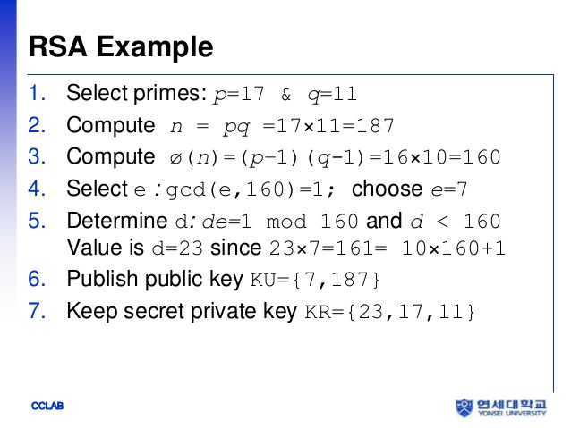
RSA algorithm – contd.
The keys are used as follows
To encrypt message m, compute ciphertext c = m^{e} mod n
To decrypt ciphertext c, compute m = c^{d} mod n
RSA Example
P = 3
Q = 11
N = 3 * 11 = 33
Φ = (3 – 1) * (11 – 1) = 2 * 10 = 20
Say, e = 3 (not a factor of 20)
Say, d = 7
3 * 7 – 1 = 20 is divisible by 20

Slide 29
RSA algorithm - contd.
Ciphertext = message³ mod 33
Message = ciphertext⁷ mod 33
Plaintext |  |  | Cipher |  | Plaintext
Sender operation |  |  |  | Receiver operation
Symbol | Numeric representation (m) | m³ | m³ mod 33 | c⁷ | c⁷ mod 33 | Symbol
H | 8 | 512 | 17 | 410338673 | 8 | H
E | 5 | 125 | 26 | 8031810176 | 5 | E
L | 12 | 1728 | 12 | 35831808 | 12 | L
O | 14 | 2744 | 5 | 78125 | 14 | O
I | 9 | 729 | 3 | 2187 | 9 | I
S | 19 | 6859 | 28 | 13492928512 | 19 | S
M | 13 | 2197 | 19 | 893871739 | 13 | M

Slide 30
Key choice in practice
Observe impact of key choice
Encryption and decryption involve different levels of computational complexity
In example
Decryption operations involve larger numbers
Specially important since operations involve exponentiation
Design choice
Which pair to use for encryption
Which pair for decryption
?
Typically, smaller number used for encryption
Support simpler devices such as smart phones

Slide 31
Hash functions
Transform input of arbitrary length into outputs of fixed length
Two properties
Unique output for each input
Infinitely many inputs share same output
Hence impossible to guess input from a given output

Slide 32
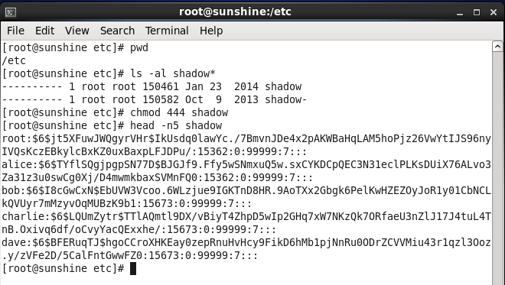
Encryption types: Hash
/etc/shadow – where CentOS password are stored on a secure system

Slide 33
Encryption in use
Secret key cryptography
Very device friendly
Minimal resources required for secrecy
Great bang-for-the-buck
But, how do you exchange the shared key?
Public key cryptography to the rescue
Too computationally intensive
However, very effective at exchanging shared secret
Hence in practice
Use public key cryptography to exchange shared secret key
Use secret key cryptography for communication
Used on SSL, VPN etc

Slide 34
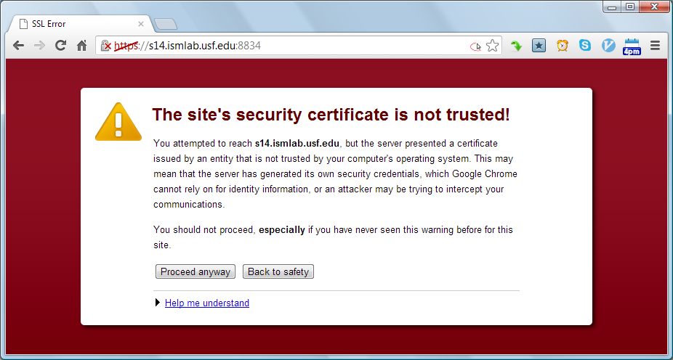
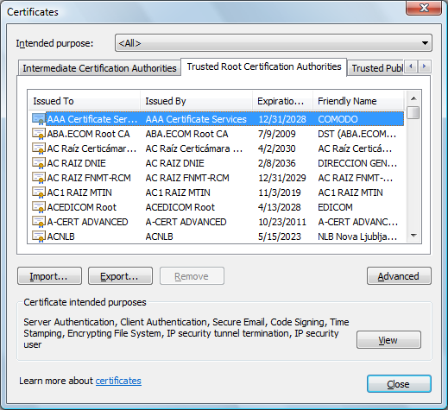
Certificate authorities
How do you verify public key?
I am USF
Really?
Browsers come with the knowledge of some “certifiers”
Called certificate authorities
Act as DMV of the Internet

Slide 35
Certificate authorities – contd.

Slide 36
Certificate authorities – contd.
Server obtains public key from well-known public key provider
Called certificate authorities (CA)
CA encrypts web server’s public key and IP address with its own private key for use as a certificate
Certificate is a bundle of information containing
Encrypted public key of the server
Identification of the key provider
Servers send their certificate to clients as identification
Certificate is decrypted using the authority’s known public key
Decrypted certificate contains the web server’s public key
For verification, browser compares
Web server’s IP address in the certificate
IP address of the server it is connected to

Slide 37
Chapter Review Questions
What is encryption?
What is encryption used for?
Briefly describe the Caser cipher.
What are the requirements of a good encryption algorithm?
Why do modern encryption algorithms use keys?
What is secret key cryptography?
Provide a brief overview of the current standard for secret key cryptography. What are some of its applications?
What is public-key cryptography?
What are some applications of public-key cryptography?
What are digital signatures?
How is public-key cryptography used to provide digital signatures?
What are hash functions? Provide a brief overview of some of the best-known hash functions.
What are hash functions used for?

Slide 38
Chapter Review Questions
What is block encryption? Why is data broken into blocks for secret key cryptography?
What is substitution in the context of encryption? 16.
What is permutation in the context of encryption? Why is it needed?
What is the confusion–diffusion paradigm of cryptography?
What is cipher block chaining? Why is it necessary?
Provide a brief overview of the RSA algorithm.
What is SSL/TLS? What is it used for?
What are some differences between SSL and VPNs?
What are certificates?
What are certificate authorities? What services do they provide?
What is PKI?
What is the need for PKI?

Slide 39
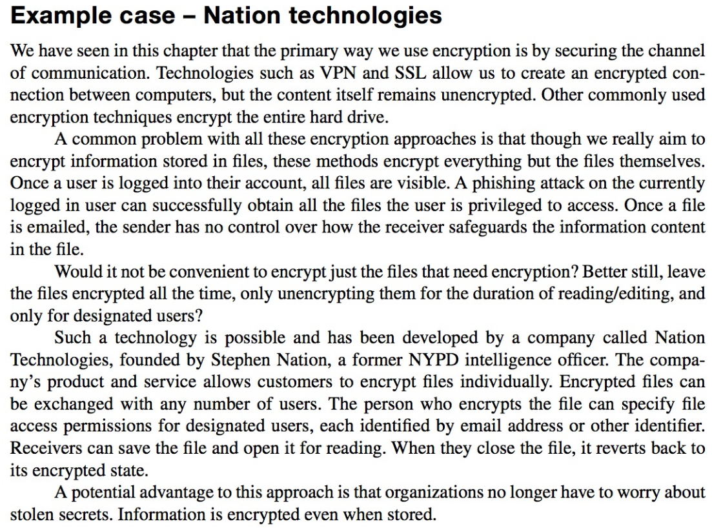
Example case: Nation Technologies

Slide 40
Example Case Questions
Visit Nation Technology’s website at www.nationtech nologies.com. What are some of the features of the company’s product?
Describe what in your opinion would be one useful way in which you might use the technology offered by Nation Technologies?
Firms in which industry in your opinion would benefit the most from the technology offered by Nation Technologies? Why?
What do you think are some of the most important business hazards faced by Nation Technologies?

Slide 41
Summary
Assets
Identification
Asset types
Characterization
Sensitivity
Criticality
Ownership
Operational responsibilities

Slide 42
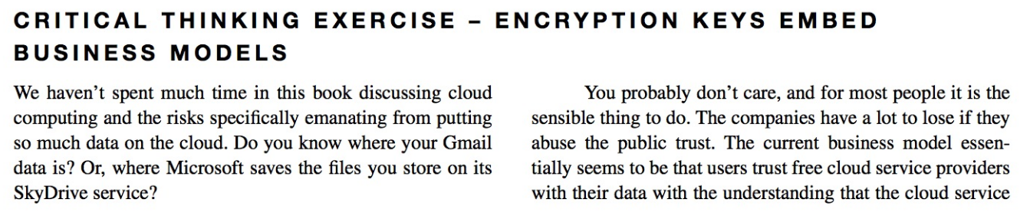
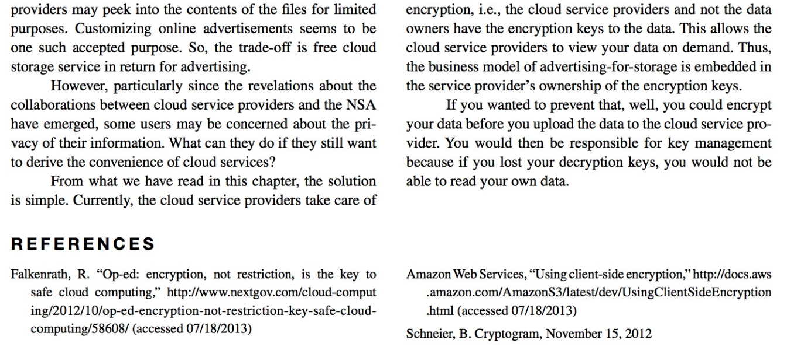
Critical Thinking Exercise

Slide 43
Critical Thinking Exercise Questions
Many popular cloud services such as Gmail are currently free because users allow advertisements in return for free service. How do you think the market will evolve if more and more data is encrypted where service providers can no longer monetize your data through advertising?
What are some special concerns of regulated organi- zations such as government agencies when it comes to cloud computing? (The Nextgov op-ed has several examples.)

Slide 44
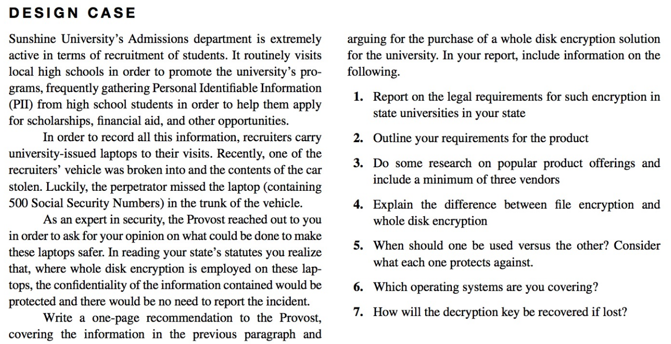
Design Case

Slide 45
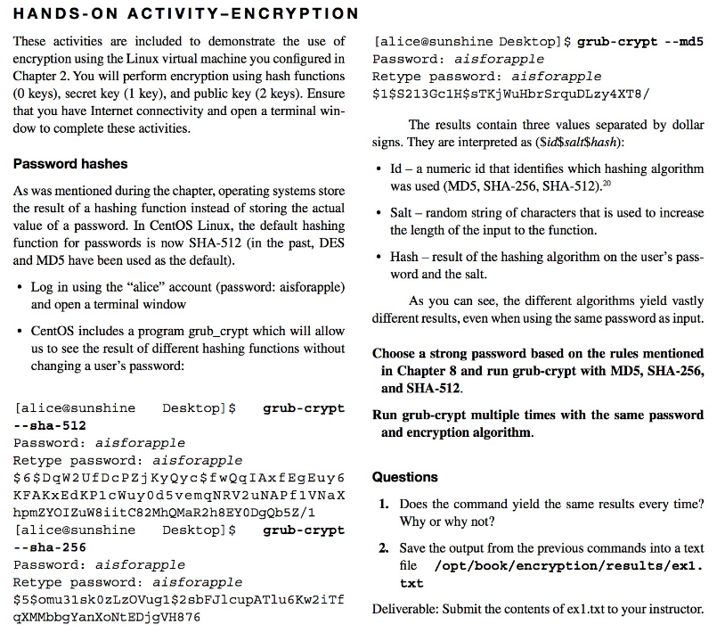
Hands-on Activity (1)

Slide 46
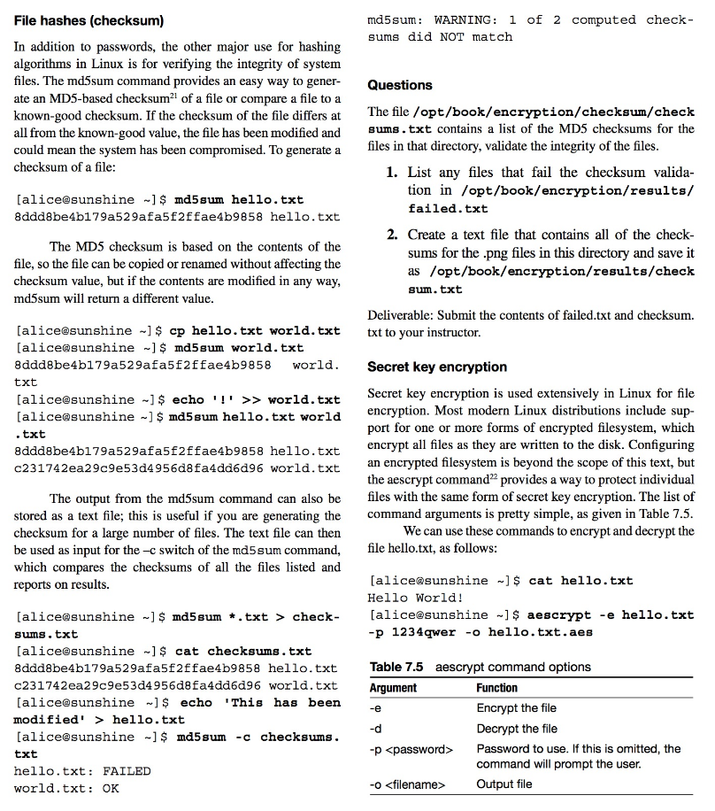
Hands-on Activity (2)

Slide 47
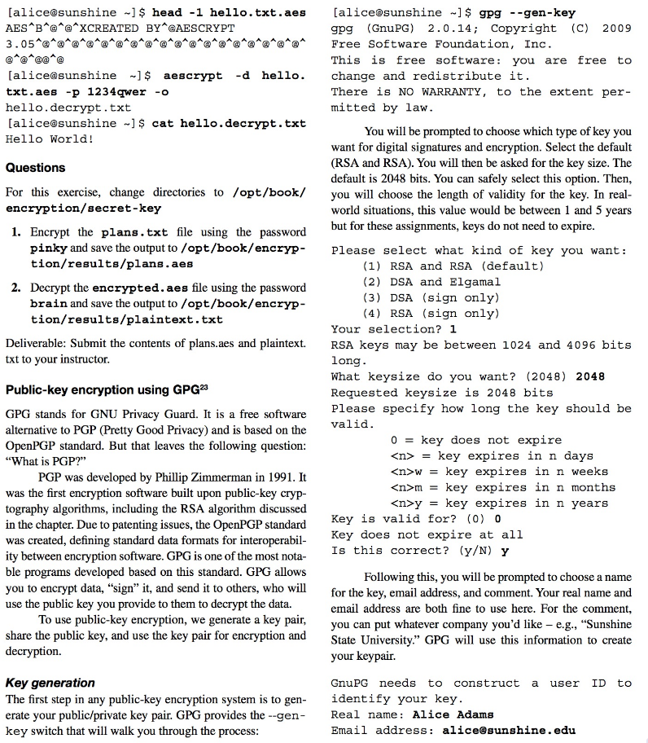
Hands-on Activity (3)

Slide 48
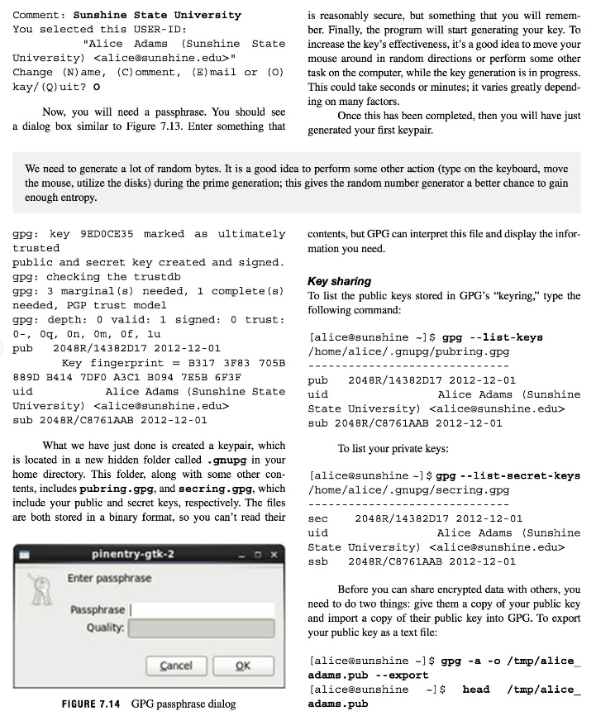
Hands-on Activity (4)

Slide 49
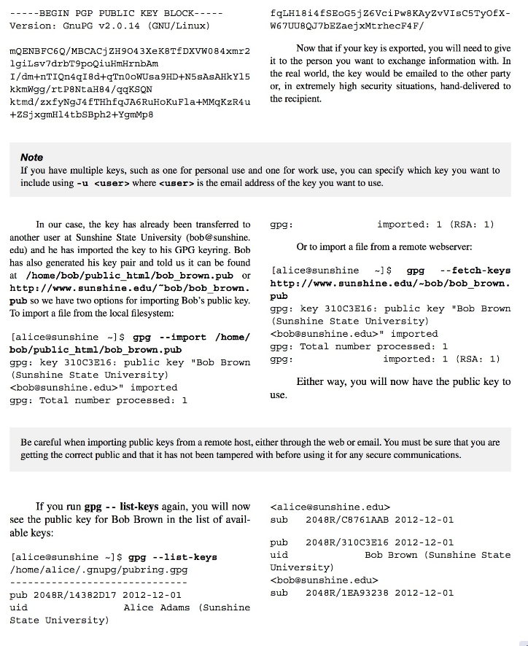
Hands-on Activity (5)

Slide 50
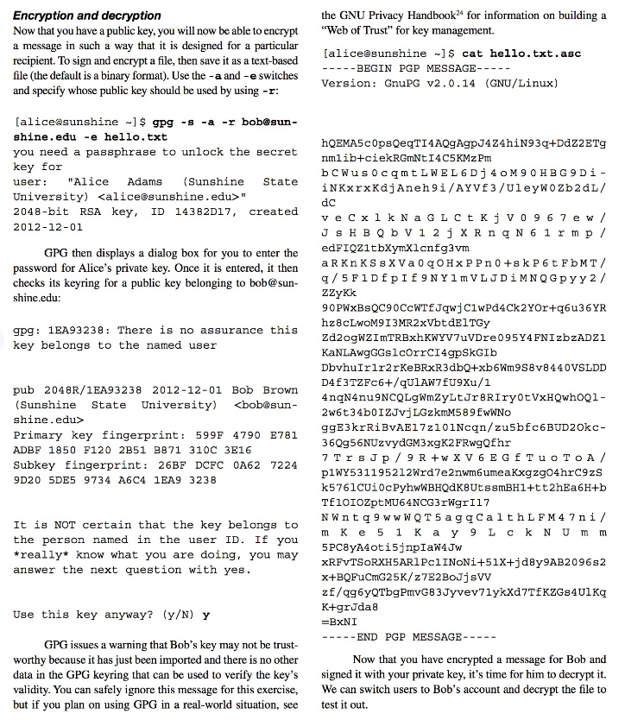
Hands-on Activity (6)

Slide 51
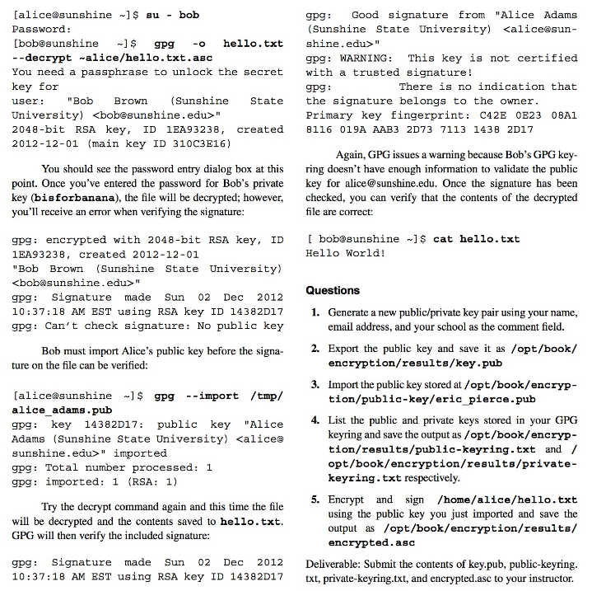
Hands-on Activity (7)

Slide 52
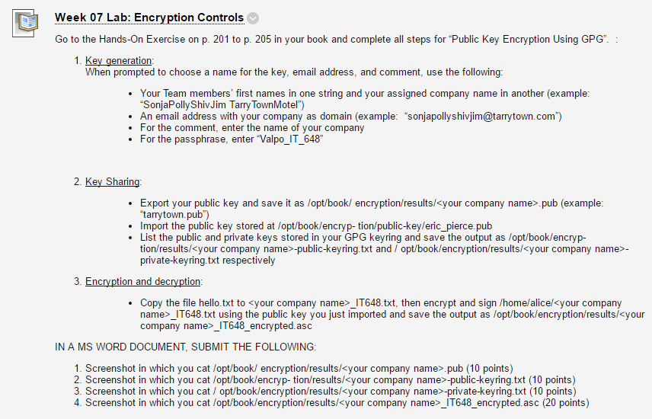
Homework Lab_7

Slide 53
Discussion 7
POST (DUE WED 11:59 pm CST): On the internet, find a description of a recent ransomware attack. How (and by whom) was the ransomware deployed? How was the ransom paid and the hijacked system restored? Do as much research as possible on this attack to find out which encryption keys were used (and how). Note that many black hats post their code on GitHub and brag about it.
DO NOT, UNDER ANY CIRCUMSTANCES, INSTALL ANY CODE OR COMMUNICATE WITH ANYONE ABOUT THE RANSOMWARE OFFERED. AS BEFORE, THIS IS A SILENT RECONNAISSANCE MISSION.
RESPONSES (due FRI 11:59 pm CST): Respond to two of your peers' posts. As a Risk Manager for your assigned company in this course, what vulnerabilities can you expect the ransomware your peers have described to exploit? How can you defend your company's assets against such an attack?

Slide 54
For Next Week
# | Topic | Reading | Due 11:59 pm CST on Blackboard
8 | Identity and Access Management: Authentication, Single Sign-On, Federation | Agrawal 8 Other materials on Blackboard | W: Post F: Responses S: LAB_8

